Slide 1
Battle of Neighborhoods
City of Toronto

Slide 2
Introduction
The purpose of this Capstone Project is to help people in exploring better facilities around their neighborhood. It will help people making smart and efficient decision on selecting great neighborhood out of numbers of other neighborhoods in Scarborough, Toronto
This Capstone Project aim to create an analysis of features for a people migrating to Scarborough to search a best neighborhood as a comparative analysis between neighborhoods. The features include median housing price and better school according to ratings, crime rates of that particular area, road connectivity, weather conditions, good management for emergency, water resources both freash and waste water and excrement conveyed in sewers and recreational facilities.

Slide 3
Data Section
Will use Scarborough dataset which we scrapped from wikipedia on Week 3. Dataset consisting of latitude and longitude, zip codes
In order to gain that information we will use “Foursquare” locational information. Foursquare is a location data provider with information about all manner of venues and events within an area of interest. Such information includes venue names, locations, menus and even photos. As such, the foursquare location platform will be used as the sole data source since all the stated required information can be obtained through the API.
The data retrieved from Foursquare contained information of venues within a specified distance of the longitude and latitude of the postcodes.

Slide 4


Map of Scarborough

Slide 5
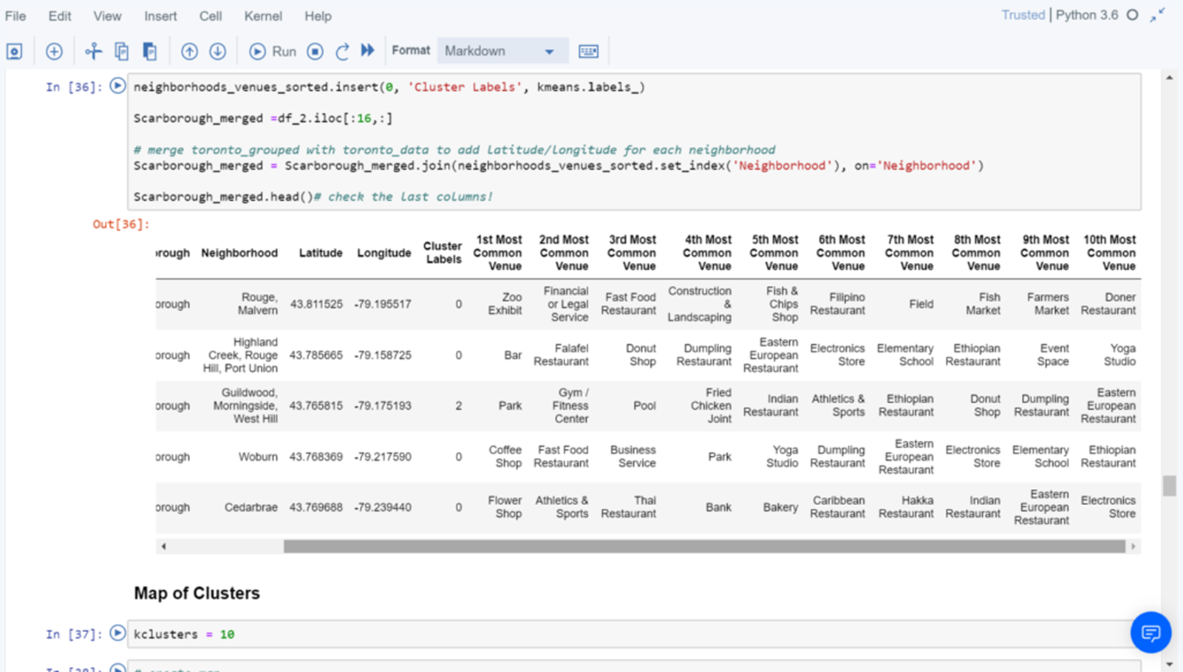
Using K-Means Clustering Approach

Slide 6
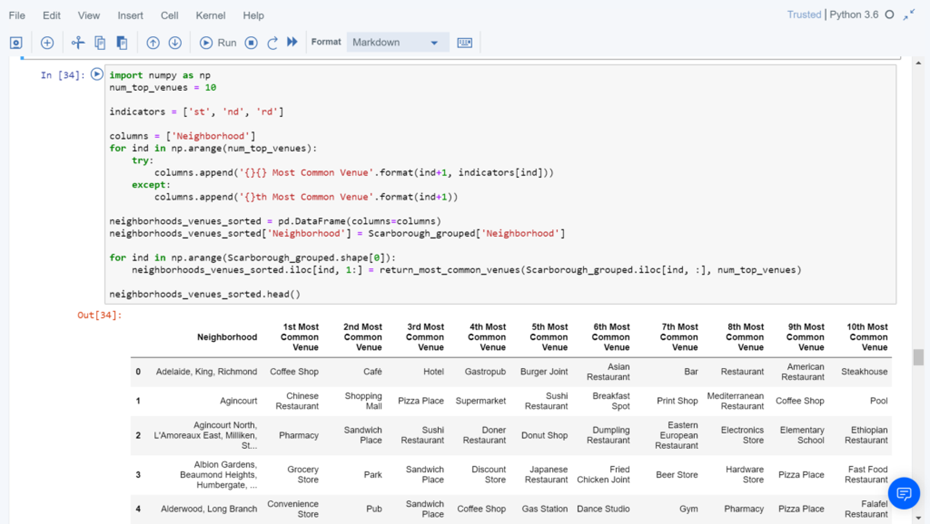
Most Common Venues near Neighborhood

Slide 7

Map of Clusters in Scarborough

Slide 8
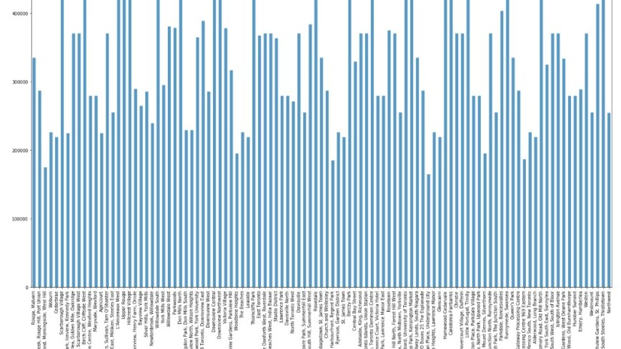
Average Housing Price by Clusters in Scarborough

Slide 9
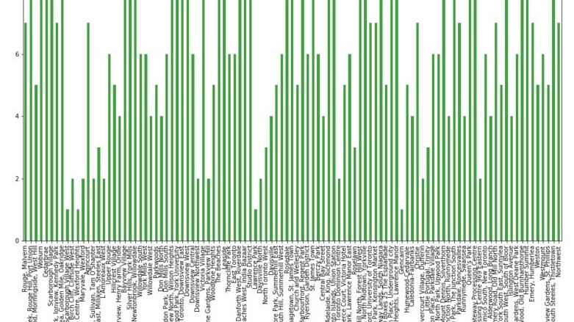
School Ratings by Clusters in Scarborough

Slide 10

Thank you

